Slide 1

UNIVERSITY COLLEGE OF ENGINEERING
BHARATHIDASAN INSTITUTE OF TECHNOLOGY CAMPUS,
ANNA UNIVERSITY, TRICHY- 620 024.
HEALTH INSURTECH AMOUNT PREDICTION
Submitted by
Manikandan S
810019205060
Praveen Kumar R
810019205077
Under the Guidance of
Mrs. S . CHITRA DEVI,
ASSISTANT PROFESSOR,
DEPARTMENT OF CSE.

Slide 2
AGENDA:
ABSTRACT.
INTRODUCTION
LITERATURE SURVEY
SYSTEM ARCHITECTURE DIAGRAM
DATA FLOW DIAGRAM
USECASE DIAGRAM
MODULE SPLIT-UP
OUTPUT OBTAINED
REFERENCES
1

Slide 3
ABSTRACT:
Health insurance is a critical aspect of healthcare financing, and its importance has grown significantly over the years.
This paper proposes a machine learning approach to predict health insurance amounts based on various factors such as age, sex, gender, BMI, smoking habits, diseased or not and no. of Children.
The proposed model employs a Random Forest Algorithm to predict the insurance amount.
The model achieves a Mean Squared Error (MSE) of 0.06, indicating that the model is robust and accurate.
KEYWORDS: MACHINE LEARNING, RANDOM FOREST ALGORITHM,
DATA PROCESSING.

Slide 4
INTRODUCTION:
Health insurance amount prediction is an essential task in the healthcare industry, as it helps healthcare providers and insurance companies to make informed decisions regarding pricing strategies and policy offerings.
The current model for predicting health insurance costs typically relies on linear and multiple linear regression, which assumes a linear relationship between dependent and independent variables.
However, this model has limitations in handling non-linear relationships, categorical variables, and missing data.
To address these limitations and potentially improve the accuracy of health insurance cost prediction, this project proposes the use of the Random Forest algorithm.
The Random Forest algorithm is a powerful machine learning technique that can handle non-linear relationships and categorical variables, as well as missing data.
This proposed work aims to develop a more accurate and robust model for health insurance cost prediction using the Random Forest algorithm.

Slide 5
LITERATURE SURVEY:
S.no | Journal Name & Year | Author | Techniques/Concepts | Advantages | Disadvantages
1 | Predict Health Insurance Cost using DNN Regression models(2021) | Mohamad Hanufy, Omar M.A.Mahmoud | Demonstrates how regression models can forecast insurance cost (x-Boost) DNN models. | Boosting Offers, Best efficiency. | This method is hardly scalable.
2 | Insurance Cost Prediction using Regression models(2022) | Sudhir Panda, Dooly Das, Manomita Chakraborty, Saroj Kumar Biswas | Linear Regression, Ridge Regression, Polynomial Regression. | Simple Procedure, More efficient to train data. | Less accuracy to predict the expected amount.
3 | Health Insurance Amount Prediction(2020) | Nidhi Bhardwaj, Rishabh Anand | Machine Learning using Decision Tree. | Non-parametric, Less data preportion. | Overfitting.
4 | Medical Insurance Cost Prediction(2021) | Edson Pinheuro de Lima Thais Carreira Pfutzenreuter | Prediction using X-Boost. | More Efficiency. | Took more time to get the output(55secs).
5 | Health Insurance Price Prediction using ML(2022) | Kashish Bhatia, Manish Kumar, Rajesh Kumar Bhatia, Navneet Kamboj | Linear regression model | Interpretability. | Overfitting.

Slide 6
6 | Insurance cost Prediction and Recommendation using Hybrid Model(2021) | N.Venkata Sailaja Mounika Karakavalasa | Hybrid Regression Models, Staking regressor | Relatively High accuracy without sacrifying the interpretability. | Process of working is difficult.
7 | Health Insurance Cost Prediction(2022) | Mukund Kulkarni, Dhammadeep D.Meshram, Bhagyesh Patil, Mridul Sharma | Multiple regression, Decision Tree, Gradient Boosting. | Train faster on datasets. | Hard to implement final model.
8 | Predicting Possible Prospects to buy Insurance Using Data Analytics(2021) | A.Sankeerthana, M.Ramya, S,Harshitha, Dr.Sunil Bhutada, Dr.Y.Rohita | Random forest Regression. | Performs both classification and regression, Handle large datasets. | Large no. of decision trees makes model too slow and ineffective for realtime predictions.
9 | Health Insurance Premium Prediction(2022) | Ghosh Madhumitha, Ravi Gor | Blockchain Technology with regression models. | Increased efficiency, Increased traceability. | Hard to correct thre mistake or make any necessary adjustments.
10 | Emerging trends of Big Data Analytics with Health Insurance in India(2016) | Shalu Gupta, Dr.Pooja Tripathi | Big Data Analytics. | It has Improved decision making. | Data is so large, Fast or complex data that is difficult to process.

Slide 7
RANDOM FOREST MODEL:
Random Forest is a supervised learning machine learning algorithm used for both Classification and Regression problems which work based on the concept of ensemble learning technique, a process of combining multiple classifiers to solve a complex problem and to improve the performance of the model.
Random Forest is a classifier that contains a number of decision trees on various subsets of the given dataset and takes the average to improve the predictive accuracy of that dataset.
Random Forest splits the training dataset into n batches of k records and root of no of independent features which contain repeated records and features with different combinations to train the n Decision Trees and make a decision based on the majority.

Slide 8
SYSTEM ARCHITECTURE DIAGRAM:
USER INTERFACE
DATA PRE-PROCESSING
RANDOM FOREST ALGORITHM
INPUT DATA
DATA TRAINING
DATA TESTING
CLASSIFICATION
REGRESSION
PREDICTING THE EFFICIENCY
DATABASE
OUTPUT
PREDICTED AMOUNT

Slide 9
Data Flow Diagram:
0th level :
Input data
Prediction
Using
Algorithm
Predicted Amount
1st level
Data Collection
Data
pre-processing
Model Selection & Training
Model Deployment
Model Evaluation

Slide 10
2nd level
Input
Data Collection
Data Analysis
Model Training
Model Selection
Data
pre-processing
Model Evaluation
Model Deployment
Predicted output

Slide 11

USECASE DIAGRAM:
System
Data Collection
Data Pre-processing
Build and train the model
DEVELOPER
Evaluate and test the model
Provide UI
USER
Enter Data
Predicted Amount

Slide 12

MODULE SPLIT UP
MODULE 1
Dataset Collection
MODULE 2
Dataset Pre-processing
MODULE 3
Model Development and Implementation
MODULE 4
UI Implementation
MODULE 5
Testing Overall system

Slide 13
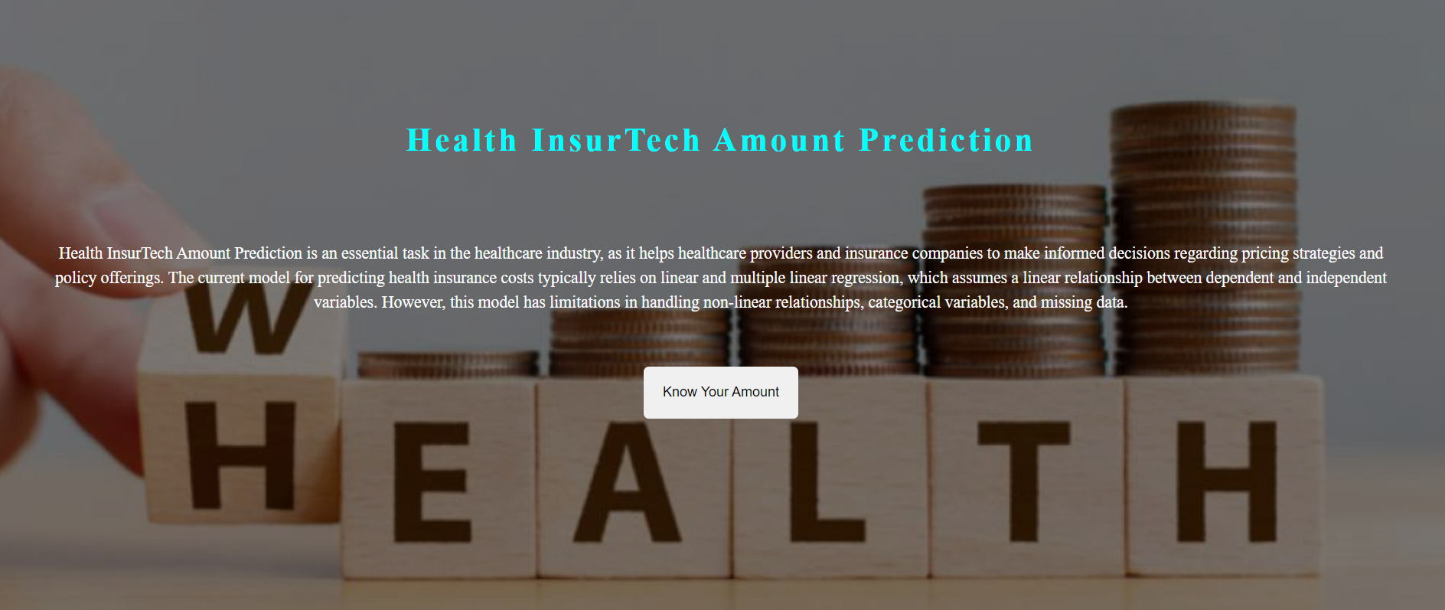
Output Obtained :

Slide 14
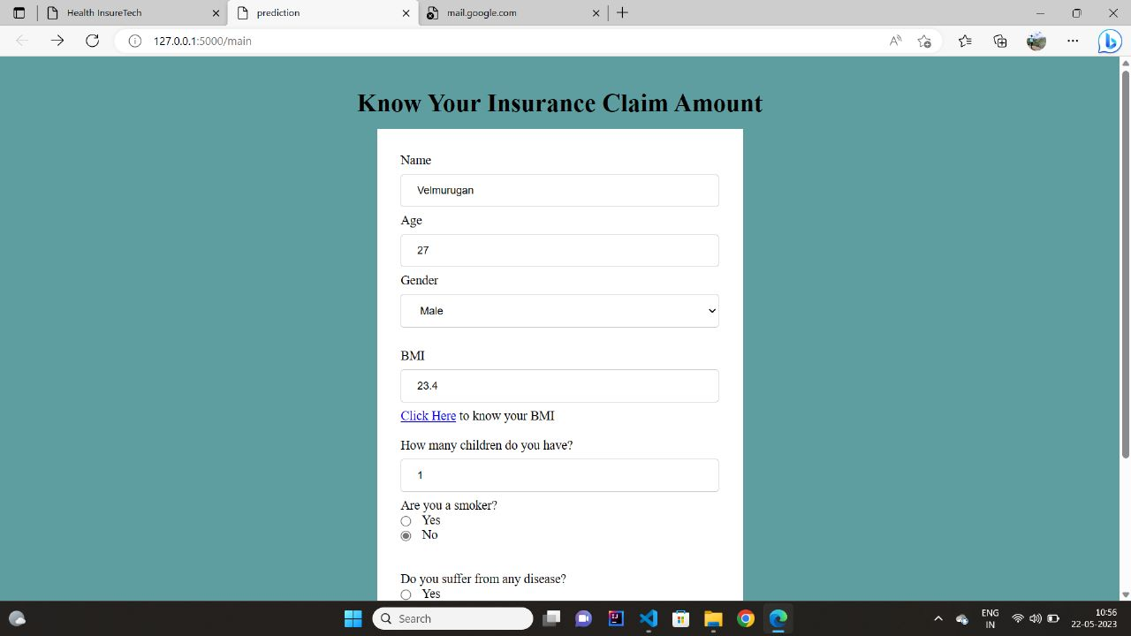

Slide 15
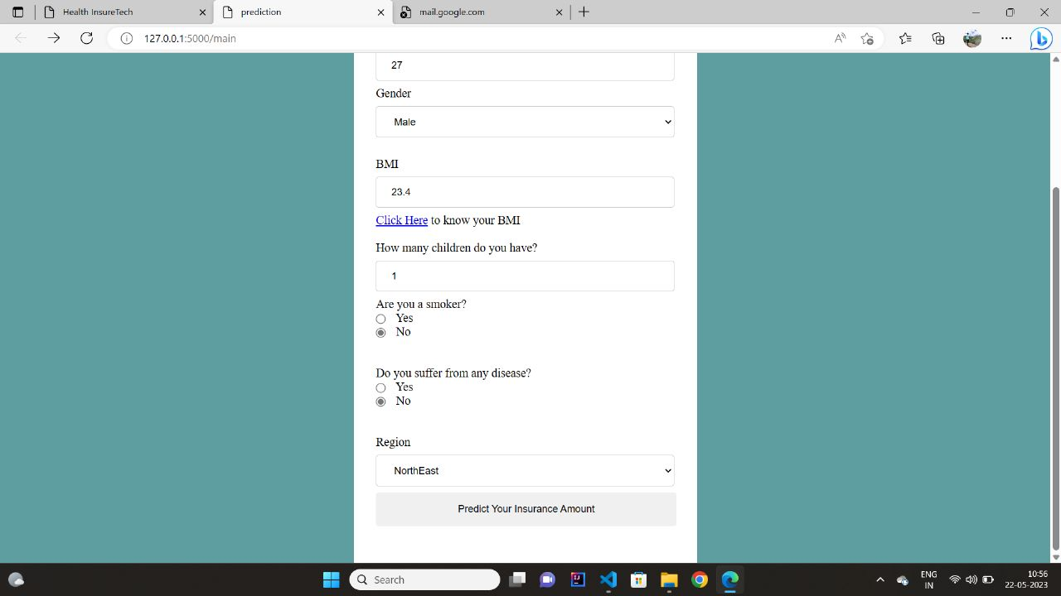

Slide 16
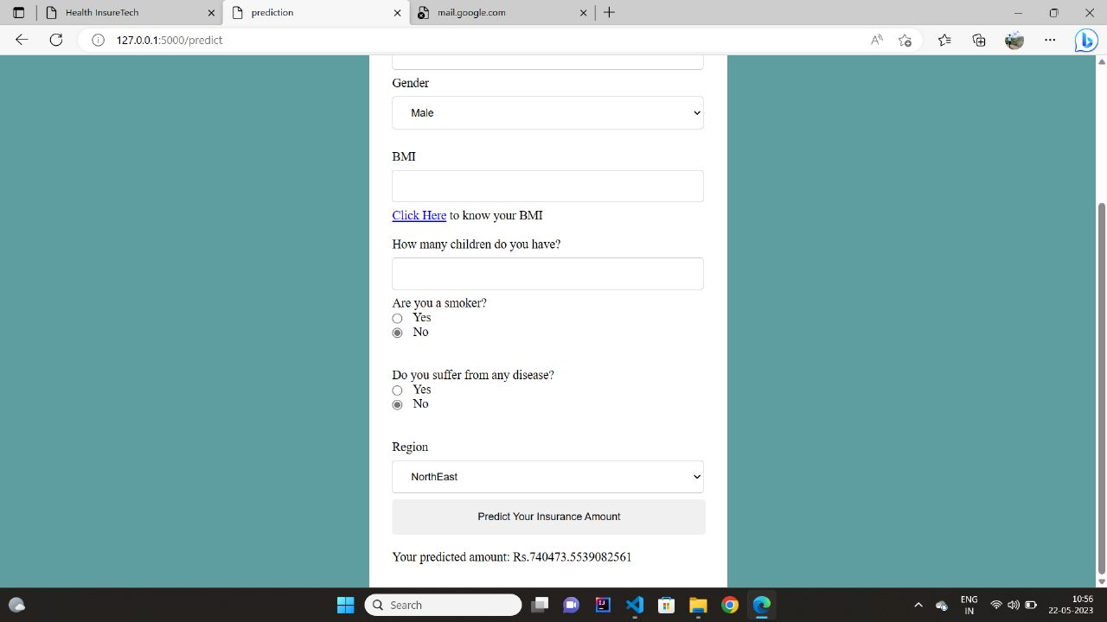

Slide 17
CONCLUSION
Calculation of health insurance charges in the traditional process are a hefty task for the insurance companies.
The results obtained are R2 of 0.88, and an accuracy of 88 percent, using the Random Forest model. Based on the model's configuration parameters which are tuned during the training phase, on the basis of performance the different proposed models are arranged.
FUTURE WORK
Add the particular diseases in the dataset sources.
Incorporating additional data sources.
One direction is to explore the use of more advanced machine learning algorithms and techniques, such as deep learning and ensemble methods, to improve the accuracy and robustness of the prediction models.

Slide 18
REFERENCES:
Hanafy, M.; Mahmoud, O.M.A. Predict Health Insurance Cost by Using Machine Learning and DNN Regression Models. Int. J. Innov. Technol. Explor. Eng. 2021.
Sudhir Panda, Dooly Das, Manomita Chakraborty, Saroj Kumar Biswas; Health Insurance Premium Prediction Using Regression Models, (COM-IT-CON), 26-27 May 2022.
Nidhi Bhardwaj , Rishabh Anand , Dr. Akhilesh Das Gupta Health Insurance Amount Prediction; International Journal of Engineering Research & Technology (IJERT) ISSN: 2278-0181 IJERTV9IS050700Vol. 9 Issue 05, May-2020.
Edson Pinheuro de Lima, Thais Carreira Pfutzenreuter;Machine Learning In Healthcare Management For Medical Insurance Cost Prediction;(2021).
Kashish Bhatia,Manish Kumar,Rajesh Kumar Bhatia,Navneet Kamboj;Health Insurance Cost Prediction using Machine Learning; (INCET) Belgaum, India. May 27-29, 2022.
Sailaja, N.V.; Karakavalasa, M.; Katkam, M.; Devipriya, M.; Sreeja, M.; Vasundhara, D.N. Hybrid Regression Model for Medical Insurance Cost Prediction and Recommendation. In Proceedings of the 2021 IEEE International Conference on Intelligent Systems, Smart and Green Technologies (ICISSGT), Visakhapatnam, India, 13–14 November 2021; pp.
Mukund Kulkarni, Dhammadeep D. Meshram , Bhagyesh Patil , Rahul More ;Medical Insurance Cost Prediction using Machine Learning, (IJRASET) December-2022 ISSN: 2321-9653.
M. Ramya, A. Sankeerthana, S. Harshitha, Dr. Sunil Bhutada ;Predicting Possible Prospects To Buy Insurance Using Data Analytics,IJCRT | Volume 9, Issue 6 June 2021 | ISSN: 2320-2882.
Ghosh Madhumita, Ravi Gor ;Health Insurance Premium Prediction Using Blockchain Technology, International Journal of Engineering Science Technologies May-June 2022, SSN (Online): 2456-8651.
Shalu Gupta , Dr. Pooja Tripathi ;An Emerging trend of Big Data Analytics with Health Insurance in India, (ICICCS 2016).

Slide 19
Thank You

